Slide 1
Hadoop MapReduce Framework and Programming Model
Tseng-Ching James Shen, PhD

Slide 2
Agenda
Motive of MapReduce
MapReduce Distributed Algorithm
YARN-based MapReduce Framework
MapReduce Application Architecture
Development of MapReduce Application

Slide 3
Motive of MapReduce
One or more of the following operations are performed for analysis on data persisted in HDFS
Descriptive analysis
Join two files with a given join key
Group the data with some fields and perform aggregate operations for each group
Predictive analysis
Calculate the mean, variance for given attributes of a dataset
Perform various matrix operations
The following two phases can be used to perform the operations in a parallel fashion
Map phase
Retrieve data (i.e. HDFS blocks) from each local machine
Redistribute the local data with a given key (used by the analysis) to another machine
Reduce phase
Apply the analytical logic to the data redistributed from all machines

Slide 4
MapReduce Distributed Algorithm
Perform Set-up Work
Map Task
Map Task
… …
Map Task
Map Task
Reduce Task
Reduce Task
Reduce Task

Slide 5
YARN-based MapReduce Framework
The MapReduce algorithm is implemented as an ApplicationMaster
The MapReduce AM does the following
Calculate the input splits (data inputs for each Map task)
Use the number of input splits to determine the number of Map tasks
Determine the number of Reduce tasks to run (via the number partitioners)
Will request the Resource Manager to allocate containers to run its Map and Reduce tasks
Map task does the following
Retrieve the data of the assigned input split which is passed to the custom Map classes as a list of key-value pairs
Run the logic implemented in the custom Map class on each input key-value pair to generate an output data which is also a key-value pair
Redistribute the value according to the generated key (shuffle phase)

Slide 6
YARN-based MapReduce Framework (Cont.)
Reduce task does the following
Copy & merge the data from the shuffle phase (sort phase)
Apply the designated logic (implemented in a custom class) on the data
Output the results to a pre-defined HDFS file
The MapReduce AM is package with the Hadoop server
Hadoop provides a default implementation where you only need to supply custom Map and Reduce classes
A MapReduce AM is created and submitted via a Hadoop MapReduce Job via which developers define
the custom Map and Reduce classes
The input files and output folder
There are different ways (explained later) developers can use to customize the MR behavior

Slide 7
MapReduce Application Architecture
Map Class
Reduce Class
MR Client Job
MapReduce AM Library
MR Client Job Library
MapReduce Framework
MapReduce API Layer
Hadoop YARN
HDFS

Slide 8
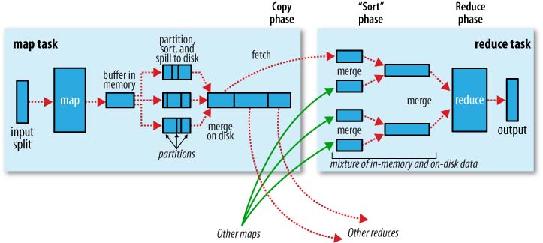
Default MapReduce Implementation

Slide 9
Development of a MapReduce Application
Implement the custom Key and Value classes
Implement the custom Map class
Implement the custom Reduce class
Implement the MapReduce Job

Slide 10
Implement custom Key and Value Classes
Key class implements the Writable and Comparable interface so the Key objects become sortable and serializable
Value class implements the Writable interface so Value objects are serializable
Developers can use the following built-in Hadoop Writable classes as Key and Value class
IntWritable
LongWritable
FloatWritable
Text
Developers can implement their own classes which implementing the following interface
interface WritableComparable<T> extends Writable, Comparable<T>

Slide 11
Hadoop MapReduce API - Map and Reduce Class -
Mapper class is a Java generic class defined with the input/output key and value type
Mapper<InputKeyType, InputValueType, OutputKeyType, OutputValueType>
Developers can use the Map class to derive the custom Map class of which the map(…) method implements the custom logic (generate the key-value pairs for Reduce tasks
Reducer class is a Java generic class with the input/output key and value type
Reducer<InputKeyType, InputValueType, OutputKeyType, OutputValueType>
Developers can use the Reduce class to derive the custom Reduce class of which the reduce(…) method implements the custom logic

Slide 12
Implement the MapReduce Job
Define a Java class with the main() method
Implement the following in main() method
Instantiate a Configuration object
Instantiate a MapReduce Job object
Set various job properties of the MapReduce Job object
Main Job class
Mapper class
Reducer class
Output Key type
Output Value type
etc.
Generate and copy the jar file
Use hadoop command to submit the job

Slide 13
Case Study Calculate Students’ Average GPA
SQL Analysis
Tables
Student(cwid, fn, ln, gender, level)
Course(cwid, courseName, gpa)
SQL implementation
SELECT s.fn, s.ln, AVG(gpa)
FROM Student s, Course c
WHERE s.cwid = c.cwid
GROUP BY cwid
How to implement with the MapReduce framework

Slide 14
MapReduce Implementation
Input folder
Output folder
MR Join Job
MR Aggregate Job
Source Files
HDFS File System

Slide 15
Customization of MapReduce Behavior
A set of MapReduce properties
Custom Partitioner classes
Different/Custom InputFormat classes

Slide 16
MapReduce Configurable Properties
mapreduce.cluster.local.dir
mapreduce.task.io.sort.mb
mapreduce.map.sort.spill.percent
mapreduce.reduce.shuffle.parallelcopies
mapreduce.reduce.shuffle.input.buffer.percent
mapreduce.task.io.sort.factor
mapreduce.reducer.tasks
etc.

Slide 17
Custom Partitioner Class
The MapReduce framework offers a generic base class – Partitioner<K, V>
The framework implements the HashPartitioner class which defines the default redistribution logic
Derives HashPartitioner class from the Partitioner class
Defines the getPartition() method
public int getPartition(K key, V value, int numReduceTasks) {
return (key.hashCode() & Integer.MAX_VALUE) % numReduceTasks;
}

Slide 18
Custom Partitioner Class (Cont.)
Implement your custom Partitioner class
Derive your custom Partitioner class from the base class
Reimplement the getPartition() method with the custom logic
Set the PartitionerClass property of the MapReduce Job object
public static class CustomPartitioner extends Partitioner<Text, Text>{
@Override
public int getPartition(Text key, Text value, int numReduceTasks){
String emp_dept = key.getDepartment();
if(numReduceTasks == 0){
return 0;
}
if(key.equals(new Text(“IT”))){
return 0;
}else if(key.equals(new Text(“Admin”))){
return 1 % numReduceTasks;
}else{
return 2 % numReduceTasks;
}
}

Slide 19
Hadoop MapReduce API - InputFormat Framework -
MapReduce framework uses the InputFormat class hierarchy to create the input splits
The class hierarchy consists of the following base classes
InputSplit
RecordReader (generic class)
InputFormat (generic class)
MR Job, Application Master and Mapper classes collaborates with the above three classes to generate and process input splits (Interaction shown in the following sequence diagram)

Slide 20
MR Client Job
Application Master
InputFormat
Mapper
Context
RecordReader
getSplits()
Input Splits
Send Input Splits
Send one Input Split
createRecordReader()
run()
getCurrentKey()
getCurrentValue()
getCurrentKey()
… …
getCurrentValue()

Slide 21
public abstract class InputFormat<K, V> {
public abstract List<InputSplit> getSplits(JobContext context) throws IOException, InterruptedException;
public abstract RecordReader<K, V> createRecordReader(InputSplit split, TaskAttemptContext context)
throws IOException, InterruptedException;
}
// Mapper run method
public void run(Context context) throws IOException, InterruptedException {
setup(context);
while (context.nextKeyValue()) {
map(context.getCurrentKey(), context.getCurrentValue(), context);
}
cleanup(context);
}

Slide 22
Built-in Input Format Classes
TextInputFormat (Default one)
KeyValueTextInputFormat
SequenceFileInputFormat (and its subclasses)
DBInputFormat
etc.

Slide 23
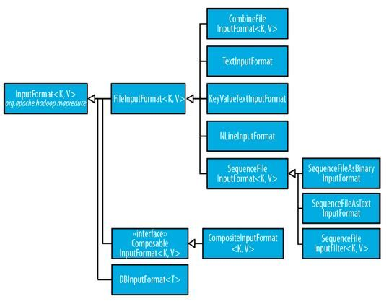

Slide 24
Development of Custom Input Format
Developers can implement the custom logic of generating the Input Splits by extending the framework as follows
Create a child InputFormat class
Create a child RecordReader class
Override the createRecordReader() method of the custom InputFormat class
Override the following methods of the custom RecordReader class
Initialize()
nextKeyValue()
Case Study I - Implementation of preventing splitting (in the Reference book)
Case Study II - Tutorial 4 : Hadoop Custom Input Format - intellitech.pro

Slide 25
Case Study I - Custom InputFormat Class -
public class WholeFileInputFormat extends FileInputFormat<NullWritable, BytesWritable> {
@Override
protected boolean isSplitable(JobContext context, Path file) {
return false;
}
@Override
public RecordReader<NullWritable, BytesWritable> createRecordReader(InputSplit split, TaskAttemptContext context) throws IOException, InterruptedException {
WholeFileRecordReader reader = new WholeFileRecordReader();
reader.initialize(split, context);
return reader;
}
}

Slide 26
Case Study I - Custom RecordReader Class -
class WholeFileRecordReader extends RecordReader<NullWritable, BytesWritable> {
private FileSplit fileSplit;
private Configuration conf;
private BytesWritable value = new BytesWritable();
private boolean processed = false;
@Override
public void initialize(InputSplit split, TaskAttemptContext context) throws IOException, InterruptedException {
this.fileSplit = (FileSplit) split;
this.conf = context.getConfiguration();
}

Slide 27
@Override
public boolean nextKeyValue() throws IOException, InterruptedException {
if (!processed) {
byte[] contents = new byte[(int) fileSplit.getLength()];
Path file = fileSplit.getPath();
FileSystem fs = file.getFileSystem(conf);
FSDataInputStream in = null;
try {
in = fs.open(file);
IOUtils.readFully(in, contents, 0, contents.length);
value.set(contents, 0, contents.length);
} finally {
IOUtils.closeStream(in);
}
processed = true;
return true;
}
return false;
}

Slide 28
@Override
public NullWritable getCurrentKey() throws IOException, InterruptedException {
return NullWritable.get();
}
@Override
public BytesWritable getCurrentValue() throws IOException, InterruptedException {
return value;
}
@Override
public float getProgress() throws IOException {
return processed ? 1.0f : 0.0f;
}
@Override
public void close() throws IOException {
// do nothing
}
}

Slide 29
public class SequenceFileMapper extends Mapper<NullWritable, BytesWritable, Text, BytesWritable> {
private Text filenameKey;
@Override
protected void setup(Context context) throws IOException, InterruptedException {
InputSplit split = context.getInputSplit();
Path path = ((FileSplit) split).getPath();
filenameKey = new Text(path.toString());
}
@Override
protected void map(NullWritable key, BytesWritable value, Context context) throws IOException, InterruptedException {
context.write(filenameKey, value);
}

Slide 30
MapReduce Failure Detection/Recovery
Transparent to users
MR jobs polls the job status from the MR Application Master which collects the status of all map/reduce tasks (via umbilical interface)
Resource Manager web UI (default port: 8088) provides the status of all running jobs
MR Application Master is responsible for
Detecting task failures
Re-running failed tasks
Mark the status of the MR job as failed if the failures can not be recovered
YARN Resource Manager is responsible for detecting and recovering from Application Master failures

